Slide 1
CMR College of Engineering & Technology
(UGC Autonomous)
Accredited by NAAC with “A” Grade
Kandlakoya, Medchal Road, Hyderabad-501401
Department of Computer Science & Engineering
LICENSE PLATE DETECTION FOR NON- HELMET MOTORCYCLISTS
Batch Number : 32
Guide Name:
Dr. V. A. NARAYANA
PRINCIPAL
Roll Numbers:
19H51A05H3- M.ISHITHA
19H51A05H7- PRATHAMESH
19H51A05L8- S.RAVEENA
CMRCET - CSE

Slide 2
Contents
Abstract
Literature Review
Existing Works
Results of Existing Systems
Proposed System
Modules
Uml diagrams
Implementation
Plan of Execution
CMRCET-CSE

Slide 3
Implementation
Plan of Execution
Future scope
Conclusion
References

Slide 4
Abstract
Motorcycles have always been the primary mode of transport in developing countries. In recent years, there has been a rise in motorcycle accidents. One of the major reasons for fatalities in accidents is the motorcyclist not wearing a protective helmet.
The most prevalent method for ensuring that motorcyclists wear helmets is traffic police manually monitoring motorcyclists at road junctions or through CCTV footage and penalizing those without helmets. But, it requires human intervention and effort.
CMRCET-CSE

Slide 5
Abstract
The proposed system first does background subtraction from video to get moving objects. Then, moving objects are classified as motorcyclists or non-motorcyclists.
For the classified motorcyclists, the head portion is located and it is classified as helmet or non-helmet. Finally, for identified motorcyclists without helmets, the motorcycle number plate is detected and the characters on it are extracted.
The proposed system uses Convolutional Neural Networks trained using transfer learning on top of a pre-trained model for classification which has helped in achieving greater accuracy
CMRCET-CSE

Slide 6
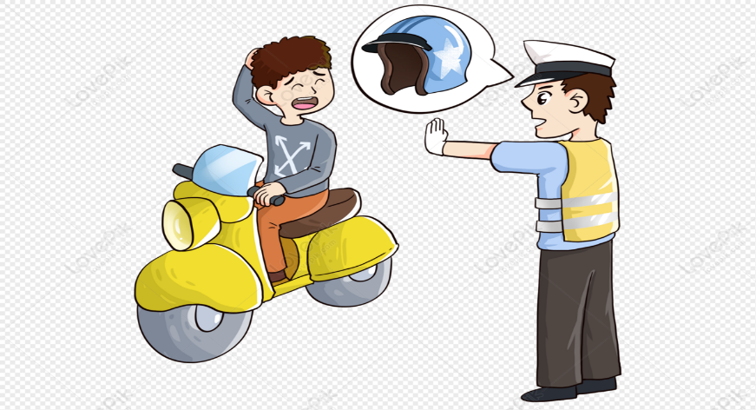
Introduction
Wearing a helmet by bike riders can significantly lessen the risks they face on the road. Because of the importance of wearing a helmet, governments have made it a crime to ride a bike without one, and they've implemented enforcement measures including random checks and other manual methods to detect those who do.
In contrast, the current image-based surveillance technologies are passive and require a lot of human intervention
CMRCET-CSE

Slide 7
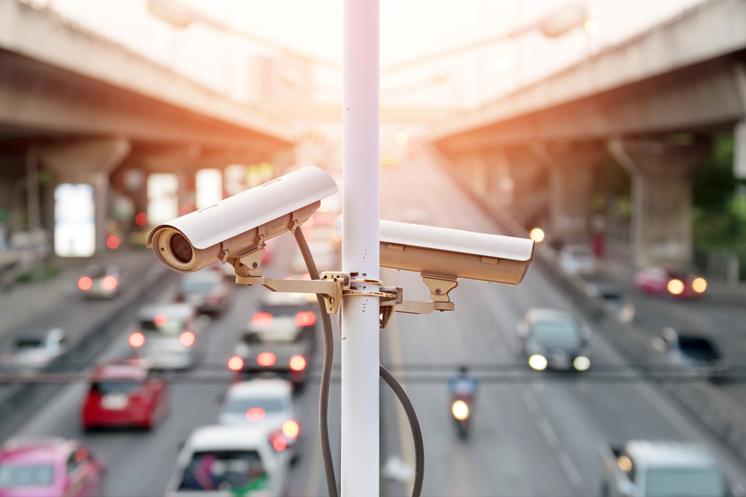
Introduction
With automation, the monitoring of these violations will be more reliable and resilient, as well as lower the quantity of human resources required. In addition, a growing number of countries have implemented systems that use cameras to monitor people in public locations.
This automation is used to develop a system for detecting bike riders without helmets using existing security camera footage in real time
CMRCET-CSE

Slide 8
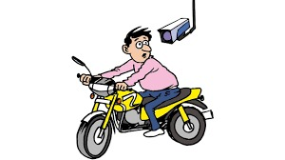
Literature Review
Over the past years, multiple approaches have been proposed to solve the problem of helmet detection. They use a background subtraction method to detect and differentiate between moving vehicles.
And they used Support Vector Machines (SVM) to classify helmets and human heads without helmets.
Then they used Hough transform with SVM to detect the head of the motorcyclist. Additionally, they extend their work by multi-layer perception model for classification of various objects.
CMRCET-CSE

Slide 9
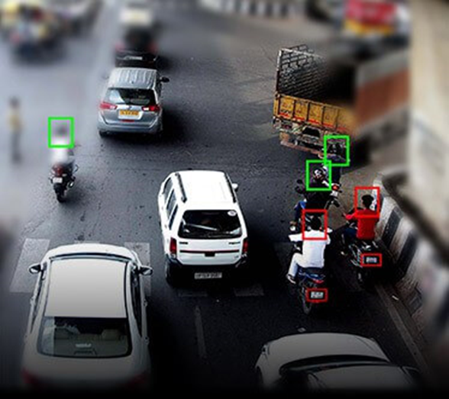
Literature Review
A circle arc detection method based upon the Hough transform. They applied it to detect helmet on the surveillance system.
The drawback of this work is that they only use geometric features to verify if any safety helmet exists in the set. Geometric features are not enough to find helmets.
CMRCET-CSE

Slide 10
Literature Review
A helmet detection system is used, and the helmet presence verifies that there is a motorcycle. In order to detect the helmet presence, the edges are computed on the possible helmet region. The Canny edge detector is used.
To detect moving objects using a k-NN classifier over the motorcyclist’s head to classify helmet.
These models were proposed based on statistical information of images and had a limitation to the level of accuracy that could be achieved.
CMRCET-CSE

Slide 11
Literature Review
With the evolution of neural networks and deep learning models there was further improvement in the accuracy of classification.
Use of CNN for classification of helmeted and non-helmeted riders. Although they use CNN, their helmet detection accuracy is poor with limitations to helmet color and multiple riders on a single motorcyclist.
Image processing and (OCR) Optical Character Recognition to detect vehicle number plate under different background but it has worked on static i.e. non - moving images.
CMRCET-CSE

Slide 12
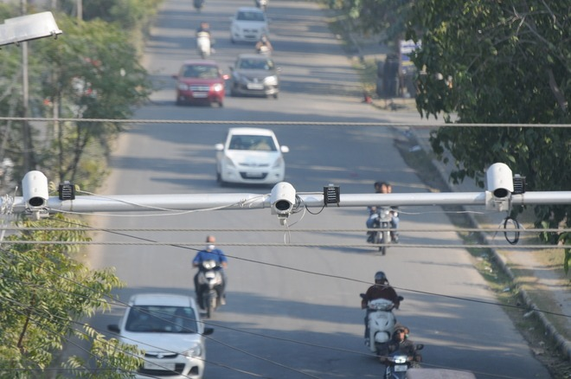
Literature Review
For detecting correctly the edges in an image and (OCR) Optical character recognition to detect the components in an image. But it was not able to detect some misaligned and different size of characters in image.
CMRCET-CSE

Slide 13
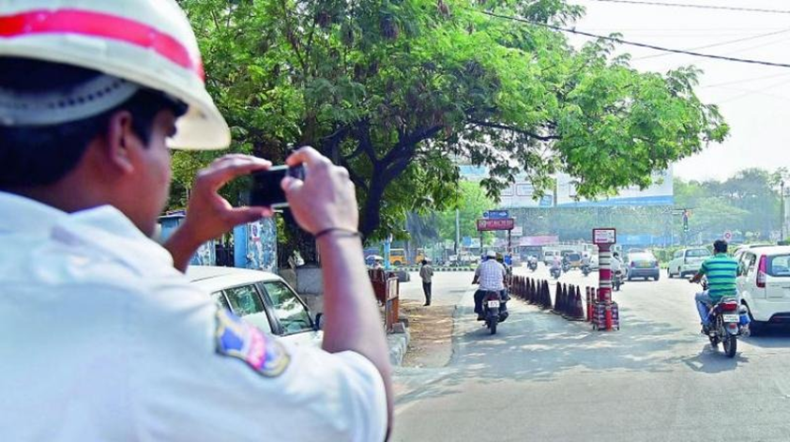
Existing Works
Traffic Police Surveillance
The existing system monitors traffic violations primarily through CCTV recordings, where the traffic police have to look into the frame where the traffic violation is happening, and zoom into the license plate in case the rider is not wearing a helmet.
CMRCET-CSE

Slide 14
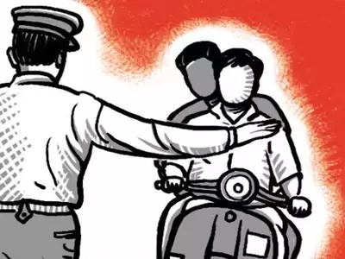
Existing Works
It is the most prevalent method for ensuring that motorcyclists wear helmets is traffic police manually monitoring motorcyclists at road junctions or through CCTV footage and penalizing those without helmets.
CMRCET-CSE

Slide 15
Existing Works
Using SVM Classifier
The system uses SVM classifier trained on features derived from image data near the head region of motorcyclists.
The selected features capture the shape of helmets where the top half of the helmet surface is brighter than the bottom half of the helmet.
It also takes into account the circular arc shape of the helmet. The system uses a circular arc detection technique.
CMRCET-CSE

Slide 16
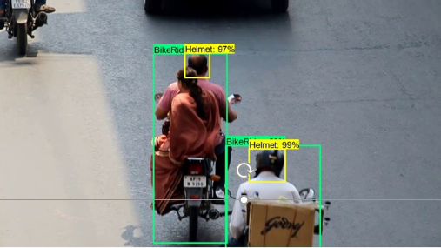
Existing Works
The main shortcoming of this approach is that it leads to a lot of misclassification, as some objects which look similar to helmets get classified as helmets and some helmets which are different do not get classified as helmets.
CMRCET-CSE

Slide 17
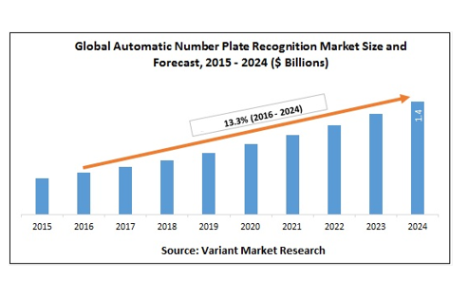
Results of Existing System
CMRCET-CSE

Slide 18
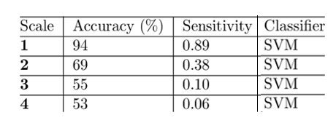
Results of Existing System
The success rate of SVM classification
CMRCET-CSE

Slide 19
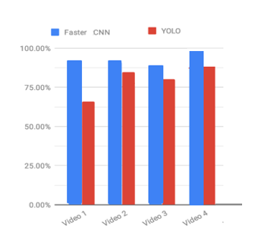
Results of Existing System
Comparison of CNN and YOLO
CMRCET-CSE

Slide 20
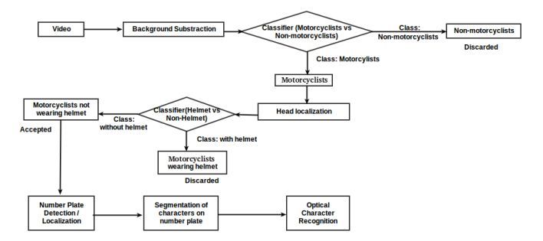
Proposed System
System Architecture
CMRCET-CSE

Slide 21
Proposed System
The proposed system is a python based application.
Algorithms used:
Convolutional Neural Networks(CNN)
YOLO Algorithm
Canny Edge Algorithm
Optical Character Recognition(OCR)
CMRCET-CSE

Slide 22
Proposed System
YOLO
YOLO is an acronym for “You Only Look Once” and it has that name because this is a real-time object detection algorithm that processes images very fast. It is an algorithm that uses neural networks to provide real-time object detection. This algorithm is popular because of its speed and accuracy. It has been used in various applications to detect traffic signals, parking meters, etc. It is the simplest object detection architecture. It predicts bounding boxes through a grid-based approach after the object goes through the CNN. It divides each image into an SxS grid, with each grid predicting N boxes that contain any object.

Slide 23
Proposed System
CNN
The convolutional Neural Network CNN works by getting an image, designating it some weightage based on the different objects of the image, and then distinguishing them from each other. CNN requires very little pre-processing data as compared to other deep learning algorithms. One of the main capabilities of CNN is that it applies primitive methods for training its classifiers, which makes it good enough to learn the characteristics of the target object. It is based on analogous architecture, as found in the neurons of the human brain, specifically the Visual Cortex. Each of the neurons gives a response to a certain stimulus in a specific region of the visual area identified as the Receptive field. These collections overlap in order to contain the whole visual area.

Slide 24
Proposed System
OCR
Optical Character Recognition algorithms can be based on traditional image processing and machine learning-based approaches or deep learning-based methods. It works by dividing up the image of a text character into sections and distinguishing between empty and non-empty regions. The OCR software uses pattern-matching algorithms to compare text images, character by character, to its internal database. If the system matches the text word by word, it is called optical word recognition.

Slide 25
Modules
Modules of Detection of Non-Helmet Riders and Extraction of License Plate Number using Yolo v8 and OCR Method
1.Upload Image
2. Detect Motor Bike & Person
The frame chosen is given as input to YOLOv2 object detection model, where the classes to be detected are „Motorbike‟, „Person‟. At the output, image with required class detection along with confidence of detection through bounding box and probability value is obtained.With the help of functions given by Image AI library, only the detected objects are extracted and stored as separate images and named with class name and image number in order.

Slide 26
Modules
3. Detect Helmet
Once the person-motorcycle pair is obtained, the person images is given as input to helmet detection model. While testing the helmet detection model, some false detections were observed. So, the person image was cropped to get only top one-fourth portion of image.This ensures that false detection cases are eliminated as well as avoid cases leading to wrong results when the rider is holding helmet in hand while riding or keeping it on motorcycle while riding instead of wearing.
4.Analysis
5.Exit

Slide 27
UML DIAGRAMS
USE CASE DIAGRAM
Use-case diagram in the Unified Modeling Language (UML) is a type of behavioral diagram defined by and created from a Use-case analysis.
Its purpose is to present a graphical overview of the functionality provided by a system in terms of actors, their goals (represented as use cases), and any dependencies between those use cases.
.

Slide 28
UML DIAGRAMS
Upload Image
Admin
Detect Motor Bike & Person
Detect Helmet
Exit
Uml diagram

Slide 29
UML DIAGRAMS
CLASS DIAGRAM
A class diagram in the Unified Modeling Language (UML) is a type of static structure diagram that describes the structure of a system by showing the system's classes, their attributes, operations (or methods), and the relationships among the classes
It explains which class contains information
user
+Upload Image()
+Detect Motor Bike & Person()
+Detect Helmet()
+Exit()

Slide 30
UML DIAGRAMS
SEQUENCE DIAGRAM
A sequence diagram in Unified Modeling Language (UML) is a kind of interaction diagram that shows how processes operate with one another and in what order.
It is a construct of a Message Sequence Chart. Sequence diagrams are sometimes called event diagrams, event scenarios, and timing diagrams.

Slide 31
User
Exit
Upload Image
Detect Motor Bike & Person
Detect Helmet
.
UML DIAGRAMS
user
Upload Image
Detect Motor Bike & Person
Detect Helmet
Exit
1. Start
2. Upload Image
3. Detect Motor Bike & Person
4. Detect Helmet
5. Exit
Sequence diagram

Slide 32
UML DIAGRAMS
ACTIVITY DIAGRAM
Activity diagrams are graphical representations of workflows of stepwise activities and actions with support for choice, iteration, and concurrency.
In the Unified Modeling Language, activity diagrams can be used to describe the business and operational step-by-step workflows of components in a system.
An activity diagram shows the overall flow of control.

Slide 33
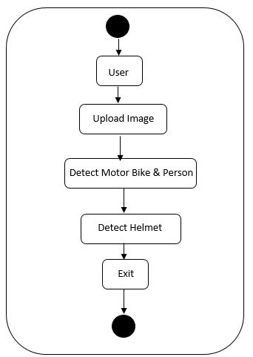
UML DIAGRAMS
.
Activity diagram

Slide 34
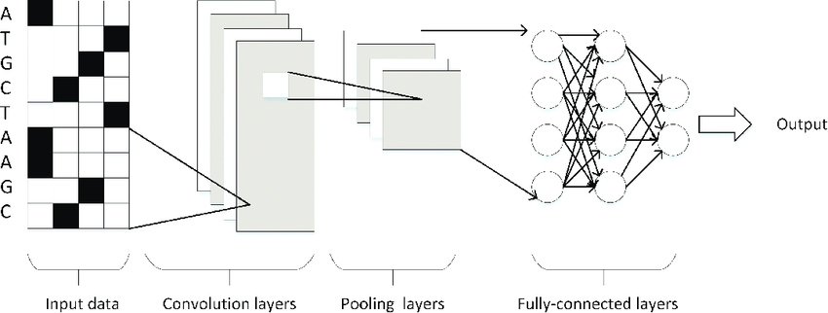
Proposed System
Yolo Architecture
CMRCET-CSE

Slide 35
Implementation
Implementation of the system for this problem statement is done using CNN classifiers. One CNN classifier is used to classify between motorcyclists and non-motorcyclists and another CNN classifier is used to classify between helmets and non-helmet.
Also, the system recognizes the number plates of motorcycles when the motorcyclist has not worn a helmet.
To obtain appropriately segmented moving objects, the Canny edge detection algorithm is applied to each frame before calculating the absolute difference between two consecutive frames.
CMRCET-CSE

Slide 36
Implementation
The canny edge detection algorithm detects a wide range of edges in an image which helps in object segmentation.
To prevent the same vehicle from getting detected more than once, the vehicles are extracted only when they reach a specific horizontal line.
Motorcyclist vs Non-motorcyclist classifier
If a moving object fed to this classifier is classified as a motorcyclist, then it is forwarded for head localization; otherwise, it is discarded.
CMRCET-CSE

Slide 37
Implementation
Head localization
For detected motorcyclist Once a moving object is classified as a motorcyclist, an image of the head portion is extracted by taking the upper one-third portion of the original image. The extracted head portion is then fed to the helmet vs non-helmet classifier.
Helmet vs Non-helmet classifier
This classifier was built similarly to the Motorcyclist vs Non-Motorcyclist classifier. If this classifier classifies the head portion image as a helmet, then the original motorcyclist image is forwarded for number plate detection; otherwise, the image is discarded.
CMRCET-CSE

Slide 38
Implementation
At this point, not only is the number plate detected but there might also be a few other parts of a motorcycle.
These are filtered out based on their orientation, height, width, and aspect ratio.
After this step, many of the candidates get filtered out (in most cases, all except the number plate get filtered).
The number plate image has numbers and letters on it separated by a white-colored area.
Therefore, more rectangles get produced for a number plate image than other images. Thus, the image with the number plate is successfully identified.
CMRCET-CSE

Slide 39
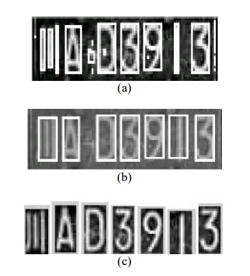
Implementation
Number plate detection for non-helmeted motorcyclists
Input motorcyclist image is first converted to grayscale.
Then, it is thresholded.
After this, the binary image obtained is inverted.
Now, the contours are found out.
Minimum area rectangles are generated around the contours.
CMRCET-CSE

Slide 40
Implementation
Segmentation of individual characters on the detected number plate
Individual characters on the number plate are segmented by thresholding the image for black color and finding contours. Their characters are then sent for Optical Character Recognition (OCR).
Optical Character Recognition of segmented characters
Google’s Tesseract Optical Character Recognition is used to recognize the characters on the number plate and the output is stored, which can be used by Transport Office to penalize the concerned motorcyclists.
CMRCET-CSE

Slide 41
Plan of Execution
The following are the steps which will be followed during processing.
Upload the photo
Background removal.
Segmentation of two-wheelers.
Detection of helmet.
If helmet not detected then number plate recognition.
CMRCET-CSE

Slide 42
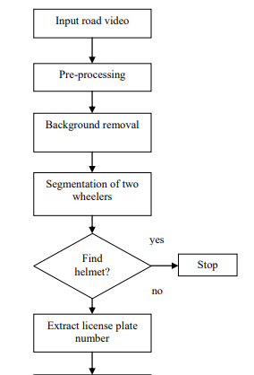

Plan of Execution
CMRCET-CSE

Slide 43
Conclusion
We have described a framework for the automatic detection of motorcycle riders without helmets from CCTV video and automatic retrieval of vehicle license number plates for such motorcyclists. The use of Convolutional Neural Networks (CNNs) and transfer learning has helped in achieving good accuracy in the detection of motorcyclists not wearing helmets. The accuracy obtained was 98.72%. But, only the detection of such motorcyclists is not sufficient for taking action against them. So, the system also recognizes the number plates of their motorcycles and stores them. The stored number plates can be then used by Transport Office to get information about the motorcyclists from their database of licensed vehicles. Concerned motorcyclists can then be penalized for a breach of law.

Slide 44
References
[1] Yogameena, B.: Deep learning-based helmet wear analysis of a motorcycle rider for intelligent surveillance system. IET Intell. Transp. Syst. 13(7), 1190– 1198 (2019)
[2] Allamki, L., et al.: Helmet detection using machine learning and automatic license plate recognition. International Research Journal of Engineering and Technology 06(12), 5 (2019)
[3] Khan, F.A.: Helmet and number plate detection of motorcyclists using deep learning and advanced machine vision techniques. In: 2020 Second International Conference on Inventive Research in Computing Applications (ICIRCA), Coimbatore, India, 15–17 July 2020
[4] Redmon, J., Farhadi, A.: YOLOv3: an Incremental Improvement. arXiv:1804.02767 [cs], (2018)

Slide 45
References
[5] Saumya, A., et al.: Machine learning based surveillance system for detection of bike riders without helmet and triple rides. In: 2020 International Conference on Smart Electronics and Communication (ICOSEC), Trichy, India, 10–12 Sept. 2020
[1]. Automatic Number Plate Recognition for Motorcyclists Riding Without Helmet. Proceeding of the 2018 IEEE International Conference on Current Trends toward Converging Technologies, Coimbatore, India. Yogiraj Kulkarni, Shubhangi Bodkhe, Amit Kamthe, Archana Patil.
[2]. R. Silva, K. Aires, T. Santos, K. Abdala, R. Veras and A. Soares, "Automatic detection of motorcyclists without a helmet," 2013 XXXIX Latin American Computing Conference (CLEI), Naiguata, 2013.
[3]. J. Chiverton, "Helmet presence classification with motorcycle detection and tracking," in IET Intelligent Transport Systems, vol. 6, no. 3, pp. 259-269, September 2012.

Slide 46

CMRCET-CSE

